Slide 1
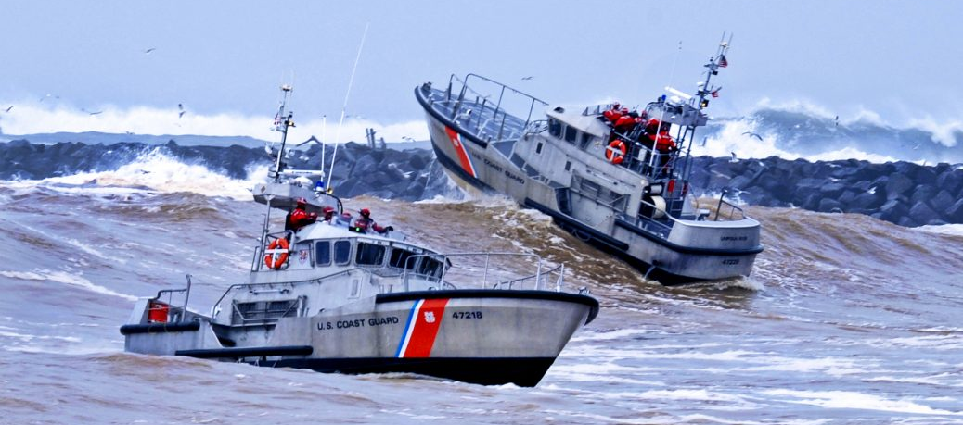
Coast Guard Operational Stress Control (CG -OSC )
Notes:
Expanded Operational Stress Control (E-OSC)

Slide 2
Terminal Objectives
Coast Guard Operational
Stress Control (CG -0SC )
DEFINE and APPLY the concepts of Coast Guard Operational Stress Control (CG-OSC) program
DESCRIBE and DEMONSTRATE strategies to build stress resilience and mindfulness within your command
IMPLEMENT and MANAGE a command stress resilience program
Notes:
Terminal Objectives
Upon completion of this training, participants will be able to:
DEFINE and APPLY the concepts of Expanded Operational Stress Control (E-OSC) program
DESCRIBE and DEMONSTRATE strategies to build stress resilience and mental fitness within your command
IMPLEMENT and MANAGE a command stress resilience program

Slide 3
Disclosure
Coast Guard Operational
Stress Control (CG -0SC )
There are no conflict of interests or commercial support to disclose
This is a Navy program, that has been adopted by the CG
There is no external funding for this work
Stress Awareness: Some of the videos or topics that are used to convey orange zone characteristics and stress behaviors may contain graphic images or language consistent with human behavior in extreme stress situations
Fair Use Disclaimer: Some video clips are derived from copyrighted productions and are used consistent with the Fair Use Act and cannot be distributed outside of the training environment:
For training/educational purposes
Is not revenue generating
Is not distributed beyond a classroom setting
Failure to adhere to the criteria of this disclaimer can result in forfeiture of rights to use the video media and/or legal action taken against the U.S. Navy.
Notes:
Disclosure
There are no conflict of interest or commercial support to disclose.
There is no external funding for this work.
Stress Awareness: Some of the video clips that are used to convey orange zone characteristics and stress behaviors may contain graphic images or language consistent with human behavior in extreme stress situations.
Fair Use Disclaimer: Some video clips are derived from copyrighted productions and are used consistent with the Fair Use Act and cannot be distributed outside of the training environment:
For training/educational purposes
Is not revenue generating
Is not distributed beyond a classroom setting
Failure to adhere to the criteria of this disclaimer can result in forfeiture of rights to use the video media and/or legal action taken against the U.S. Navy.

Slide 4
Culture of Excellence
Coast Guard Operational
Stress Control (CG -0SC )
A CG wide approach that empowers the Fleet to achieve SPIRIT of excellence by fostering psychological, physical and emotional toughness, promoting organizational trust and transparency and ensuring inclusion and connectedness.
Cultural Champion Network
CG-OSC
Notes:
Culture of Excellence
Looking at this slide, how can the CG Develop our own culture of Excellence?
HFP Human Factors Process
Department of Defense Instructions and Directives form the base of OSC and subsequent programs.
DoD Directive 5124.02 “Under Secretary of Defense for Personnel and Readiness” (USDPR)
DoD Directive 6490.5 “Combat Stress Control (CSC) Programs”
DoD Instruction 6490.03 “Deployment Health”
Marine Corps Reference Publication (MCRP) 6-11C “Combat and Operational Stress Control
E-OSC
NAVADMIN 222/19
CgOSC
BUMED Instruction 63xx.xx
OSCAR
a. Marine Corps Order 5351.1

Slide 5
OSC Program
Coast Guard Operational
Stress Control (CG -0SC )
Standardized primary toughness, prevention and recognition program to support building resilience, commitment and preparation to support operational readiness
Concepts are designed to address stress and stress reactions with the overall objective of increasing capacity to focus, perform and persevere through the challenges associated with military operations
Will leverage HSWL resources and deckplate leadership to provide more accessible, collaborative resources and real-time assessments of unit culture to promote healthy command climates and mitigate risks associated with unaddressed stress and stressors
Notes:
CG-OSC Program
Standardized primary toughness, prevention and recognition program to support building resilience, commitment and preparation to support operational readiness
Concepts are designed to address stress and stress reactions with the overall objective of increasing capacity to focus, perform and persevere through the challenges associated with military operations
Will leverage HSWL Resources and deckplate leadership to provide more accessible, collaborative resources and real-time assessments of unit culture to promote healthy command climates and mitigate risks associated with unaddressed stress and stressors.

Slide 6
Objectives
Coast Guard Operational
Stress Control (CG -0SC )
Build and preserve resilience Learn techniques to support self-regulation and performance Early recognition of individuals or units in distress | Breaking the code of silence related to occupational stress reactions Peer-intervention- engaging individuals in early help as needed to maintain mission and personal readiness Connection with services (as needed)
Notes:
E-OSC Core Objectives
Build and preserve resilience
Learn techniques to support self-regulation and performance
Early recognition of individuals or units in distress
Breaking the code of silence related to occupational stress reactions
Peer-intervention- engaging individuals in early help as needed to maintain mission and personal readiness
Connection with services (as needed)

Slide 7
OSC Core Objectives
Coast Guard Operational
Stress Control (CG -0SC )
Build and preserve resilience Learn techniques to support self-regulation and performance Early recognition of individuals or units in distress | Breaking the code of silence related to occupational stress reactions Peer-intervention- engaging individuals in early help as needed to maintain mission and personal readiness Connection with services (as needed)
Notes:
E-OSC Core Objectives
Build and preserve resilience
Learn techniques to support self-regulation and performance
Early recognition of individuals or units in distress
Breaking the code of silence related to occupational stress reactions
Peer-intervention- engaging individuals in early help as needed to maintain mission and personal readiness
Connection with services (as needed)

Slide 8
OSC as a Prevention Tool
Coast Guard Operational
Stress Control (CG -0SC )
Detectable signs or symptoms
Mindfulness
Flexible Thinking
Problem Solving
COSFA
Buddy care
Core Leader Functions
Identified
individuals
Tertiary
Mindfulness
Flexible Thinking
Healthy Behaviors
Problem Solving
EQ
COSFA
Buddy care
Core Leader Function
Elevated risk or early exposure to
a destructive behavior
Target subsets
of population
Secondary
Prevention of destructive behaviors
Stress-resilience
Values
Mindfulness
Flexible Thinking
Health Behaviors
Problem Solving
Core Leader Functions
Entire
population
Primary
Unit Assessment to support
organizational surveillance for stress indicators
Notes:
E-OSC as a Prevention Tool
Types of Prevention
Primary Prevention – Prevention of destructive behaviors takes place before destructive behaviors occur. It involves strategies that reduce risk factors and increase protective factors associated with destructive behaviors.
Secondary Prevention – Aims to address elevated risk or early exposure to a destructive behavior by reducing the likelihood of recurrence and long-term impacts. Some common examples of secondary prevention are prompt reporting after behavior occurs, immediate response to behavior, treatment offered or administered.
Tertiary Prevention – A long-term approach after destructive behaviors occur.

Slide 9
Coast Guard Operational
Stress Control (CG -0SC )
Not Engaged
Ready
Reacting
Injured
Ill
Disinterested
Unmotivated
Unfocused
No initiative
Unproductive
Lack of interest in work relationships
Good to go
Well-trained
Fit and focused
Connected
Accepting new challenges
Active coping
Quick temper
Irritable
Diminished self-control
Poor focus
Poor sleep
Pushing others away
Nausea
Temporary & transitory, needed for growth
Serious or significant distress or
Overwhelming Emotions*
Insomnia, nightmares.
Breaking relationships
Shame, guilt
Destructive behavior
Stress injuries that don’t heal without help.
Diagnosable mental health and Substance use disorders.
LEADERSHIP
OPPORTUNTIY
OPTIMAL PERFORMANCE!
(Does not mean absence of stress)
SELF-CARE OPPORTUNITY
POINT OF INTERVENTION
RECOVERS WITH EFFECTIVE CARE & REINTEGRATION
Unit Leader Responsibility
Individual, Peer, Family Responsibility
Caregiver Responsibility
Notes:
E-OSC as a Prevention Tool
Types of Prevention
Primary Prevention – Prevention of destructive behaviors takes place before destructive behaviors occur. It involves strategies that reduce risk factors and increase protective factors associated with destructive behaviors.
Secondary Prevention – Aims to address elevated risk or early exposure to a destructive behavior by reducing the likelihood of recurrence and long-term impacts. Some common examples of secondary prevention are prompt reporting after behavior occurs, immediate response to behavior, treatment offered or administered.
Tertiary Prevention – A long-term approach after destructive behaviors occur.

Slide 10
Current SITREP on Stress
Coast Guard Operational
Stress Control (CG -0SC )
Operational demands and training requirements are constantly changing
Pre-deployments, deployments and work-ups take priority over everything else
Military life is challenging
Service members MUST perform well even when under enormous stress
Coast Guard Members, and their families may be resistant to learning new resilience strategies
Stigma
Belief that only those who are struggling will benefit from these skills
Notes:
Current Situational Report (SITREP) on Stress
The nature of the military life and operations makes it necessary, but also extremely difficult to develop and implement effective resilience programs.
Operational demands and training requirements are constantly changing
It can be quite difficult to implement large-scale classroom type training in the military because of operational demands like deployments, and pre-deployment work-ups that take precedence over everything else
Annual and Weight requirements can become overwhelming, and CG Members may become disinterested in trainings, viewing them as “checks in the box”
Military life is challenging
Sailors and Marines MUST perform well even when under enormous stress and are afforded little margin for error
Family members cannot put their personal lives on hold to deal with the stress of deployments, training cycles, and other stresses inherent with having a loved-one who serves
Sailors, Marines, and their families may be resistant to learning resilience strategies
Some may be concerned about stigma, and feel that practicing these skills is admitting to weakness
Others assume that they are coping well, and believe that only those who are struggling will benefit from these skills
In order to address these problems, the CG needs to develop engaging and practical programs that can teach Sailors, Marines, and families how to enhance individual resilience.

Slide 11
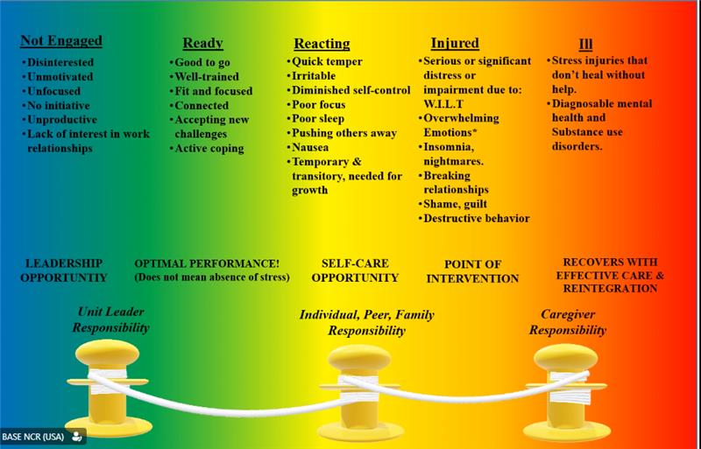
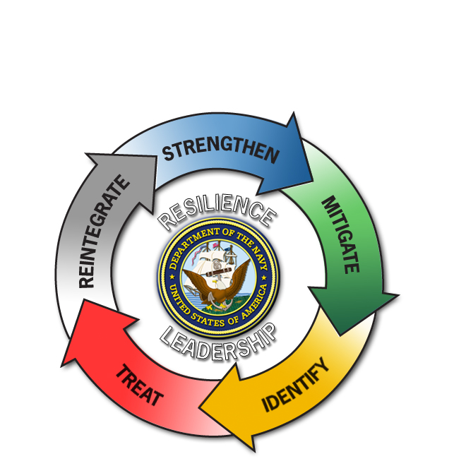
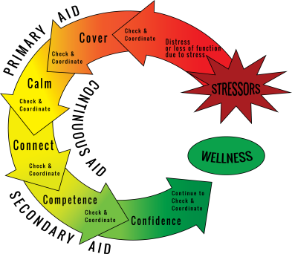
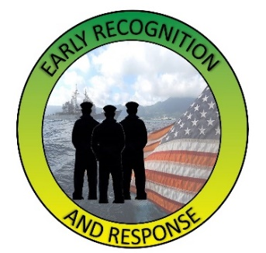
Key Components
Coast Guard Operational
Stress Control (CG -0SC )
Resilience
Stress Continuum Model
Core Leader
Functions
Critical Operational
Stress First Aid (COSFA)
Buddy Care &
Unit Assessment
Total Force Wellness Tool
Notes:
Key Components
Resilience is one’s capacity to adapt successfully and function competently to life’s challenges, adversity, stress, and trauma. Evidence-based individual resilience skills that are associated with building and preserving resilience are: mindfulness, values, flexible thinking, healthy behaviors & problem solving.
The Stress Continuum Model is a spectrum of stress responses categorized in four zones identifying stress responses: Green “Ready” zone, Yellow “Reacting” zone, Orange “Injury” zone and Red “Illness” zone. It is a tool and is a common language that allows us to identify, engage and intervene when stress reactions or injuries are present.
The Core Leader Functions were developed to reinforce a leader’s commitment to sailors, families and overall command psychological health. The following are action elements for leaders to use to manage an environment conducive to dealing with operational stress and to develop resilience – strengthen, mitigate, identify, treat and reintegrate.
Combat & Operational Stress First Aid (COSFA) is a flexible multi-step process for the timely assessment and preclinical care of psychological stress injuries in individuals or units with the goals to preserve life, prevent further harm and promote recovery. The action steps of COSFA are - check, coordinate, cover, calm, connect, competence and confidence.
Buddy Care and Unit Assessment are Command Resilience Team (CRT) intervention tools used to assess individuals and or units during times of stress.
Buddy Care uses peers who are trained to provide social and emotional assistance and to create a safe and trusting environment. It is observing, identifying and intervening with peers when stress symptoms become apparent.
A Unit Assessment is used as a foundation for providing actionable recommendations for leaders to a unit that has been exposed to one or more stress injuries (Wear & Tear, Inner Conflict, Loss, & Life Threat).
Stress-o-Meter (SoM) is a web-based tool developed to provide a confidential real- time “snapshot’ of the stress level for command personnel. The Stress-o-Meter collects subjective information based on the Stress Continuum and creates a “dashboard” for command leadership. This “dashboard” illustrates the “temperature” of the command, Directorate, or Department to assist leaders with understanding staff stress levels and to determine if there is a need for an intervention.

Slide 12
Facilitation Discussion Questions
Coast Guard Operational
Stress Control (CG -0SC )
What are the learning objectives for this module? How do they fit in overall CG-OSC terminal objectives?
What are core concepts & critical exercises (must have’s) for this module if time limited?
How do we balance facilitation, group discussion, lecture, & worksheets?
How do we create linkages in modules & objectives in mind’s of students?
How does this module connect & reinforce other modules?
What are our running themes & how can we reinforce them throughout each module?
Notes:
Facilitation Discussion Questions
What are the learning objectives for this module? How do they fit in overall E-OSC terminal objectives?
What are core concepts & critical exercises (must have’s) for this module if time limited?
How do we balance facilitation, group discussion, lecture, & worksheets?
How do we create linkages in modules & objectives in mind’s of students?
How does this module connect & reinforce other modules?
What are our running themes & how can we reinforce them throughout each module?

Slide 13
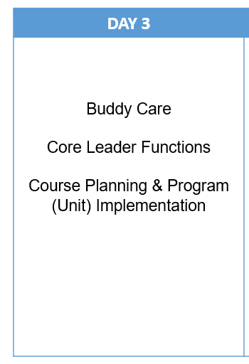
Agenda
Coast Guard Operational
Stress Control (CG -0SC )
DAY 1 | DAY 2
Stress & Resilience Mindfulness CG Values & A Culture of Excellence Valued Living Emotional Intelligence (EQ) | Flexible Thinking Healthy Behaviors Problem Solving Operational Stress Control
Notes:
Agenda
E-OSC is designed to be a flexible program with concepts that can be adapted to fit the demands of various commands. Instructor Trainers have the option to adapt the course materials to fit different time constraints by focusing on key-concepts, rather than teaching as full modules.
E-OSC curriculum includes 15 modules.
Day 1:
Module 1: Program Overview & Introductions
Module 2: Stress & Resilience
Module 3: Mindfulness
Module 4: CG Values & A Culture of Excellence
Module 5: Valued Living
Module 6: Emotional Intelligence (EQ)
Module 7: Flexible Thinking
Day 2:
Module 8: Healthy Behaviors
Module 9: Problem Solving
Module 10: Combat & Operational Stress Control (COSFA)
Module 11: Buddy Care
Module 12: Unit Assessment
Module 13: Stress-o-Meter (SoM)
Module 14: Course Planning & Program (Unit) Implementation
Course Review & Discussion

Slide 14
Participant Introductions
Coast Guard Operational
Stress Control (CG -0SC )
Name
What command are you with?
What are your expectations for this training?
What is something unique about yourself?
Notes:
Participant Introductions
Directions: Ask participants to introduce themselves by answering the following questions.
Time Allotted: 15 minutes
Name
What command are you with?
What are your expectations for this training?
What is something unique about yourself?

